Slide 1



Early detection of colon cancer
ED-CRC

Slide 2
01
Project Summary
02
Problem definition
CONTENT
03
Project Specifications
04
Time plan
05
References

Slide 3
Develop a machine learning-based system for early detection of colon cancer using classification and segmentation techniques.
KVASIR and CVC-612 datasets.
Improved Patient Outcomes.
Reduced Healthcare Costs.
Friendly GUI.
Project
Summary
3

Slide 4
Problem definition
1
2
The problem we are going to solve.
Motivation
4
3
Our solution
Previous solutions.

Slide 5
The problem we are going to solve
Automatic detection of more polyps at an early stage.
High incidence and mortality rates of colon cancer.
Screening methods for colon cancer are not always accurate.
Addressing a significant public health issue.
Help doctors to improve the diagnosis and treatment of colon cancer.
5

Slide 6
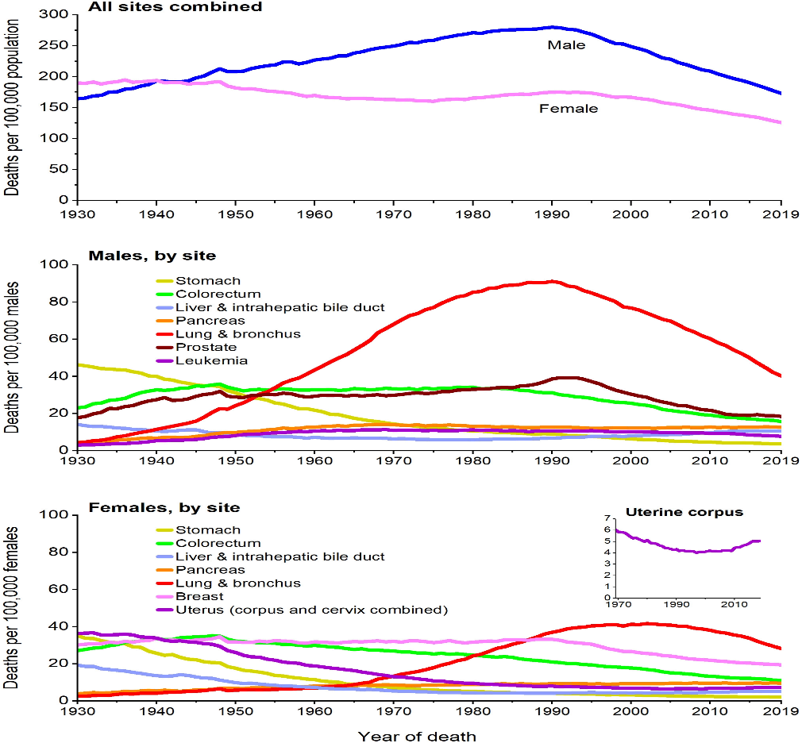
Cancer is a leading cause of death worldwide, accounting for nearly 10 million deaths in 2020, or nearly one in six deaths, Cancer is the second cause of death worldwide, a total of 1.9 million new cancer cases and 609,360 deaths from cancer are expected to occur in the US in 2022, which is about 1,670 deaths a day. By American cancer society
Motivation
6

Slide 7
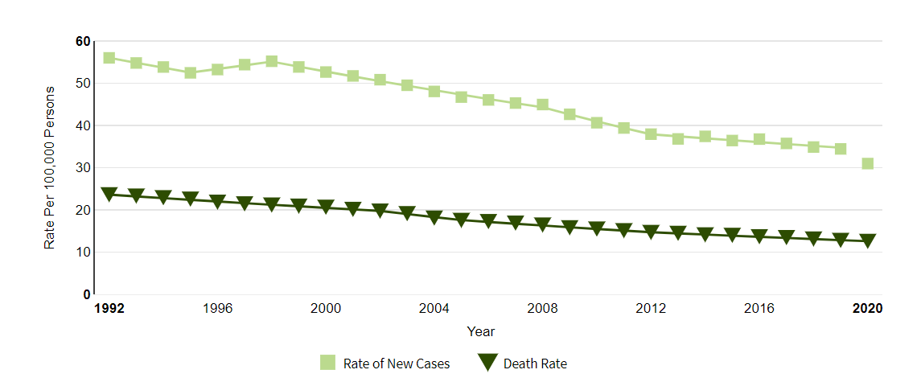
Colon Cancer
The rate of new cases of colorectal cancer was 36.6 per 100,000 men and women per year.
The death rate was 13.1 per 100,000 men and women per year.
By National Cancer Institute
7

Slide 8
Early detection
The good news is that deaths from this disease have declined compared with a decade ago, and early detection is apparently one reason.
If a doctor catches the cancer while it's still confined to the outer lining of the colon or rectum, you can probably look forward to a full recovery.
When colorectal cancer is found at an early stage before it has spread, the 5-year relative survival rate is about 90%, When cancer has spread outside the colon or rectum, survival rates are lower.
This news based on American cancer society.
8

Slide 9
Previous solutions
Stage 1 – Classification
Paper by | Year | Models | Accuracy
Konstantin Pogorelov & Kristin Ranheim Randel & Carsten Griwodz & Thomas de Lange | 2017 | 6-Layers CNN 3-Layers CNN Inception V3 TFL 2 GF random forest | 91% 95% 92% 92%
John Mitchell | 2022 | VGG16 Resnet18 GoogLeNet | 96.33% 78.83% 91.21%
9

Slide 10
Previous solutions
Stage 2 – Segmentation
Paper | Year | Models | Dataset | Mean IOU
Ange Lou & Shuyue Guan & Murray Loew | 2021 | CaraNet | Kvasir CVC-612 | 86% 88%
Ibtesam M. Dheir & Samy S. Abu Naser | 2021 | Res-Unet++ + CRF + TTA | Kvasir-seg CVC-ClinicDB | 83.29% 85.08%
Nikhil Kumar Tomar & Ulas Bagci & Debesh Jha | 2023 | RupNet | Kvasir-seg | 76.58%
10

Slide 11
Limitation of previous work
Limitations
They considered the sizes of small objects only.
They did not augment the datasets together.
They didn’t apply additional preprocessing steps to the data
11

Slide 12
How to solve the problem?
We will solve the problem using two techniques:
Classification
It aims to classify medical images into different categories.
Divided into two steps:
Extracting effective features from the image.
Using the features to build models that classify the image dataset.
Polyp
Normal
12

Slide 13
Segmentation
Image segmentation is the technique of dividing images into meaningful Regions of Interests (ROIs) that are simple to analyze and interpret.
The predicted output of the process is an image contains the ROIs only called Mask.
The goal of image segmentation is to assign a label to each pixel of the image so the pixels with the same label share specific characteristics.
As segmentation reduce the risk factors of the colon cancer, it helps doctors to detect the location of the cancer, so the survival of the patient will be faster.
13

Slide 14




02
04
Discussion & results
01
03
Stakeholders
System
architecture
Time Plan
Conclusion
14

Slide 15

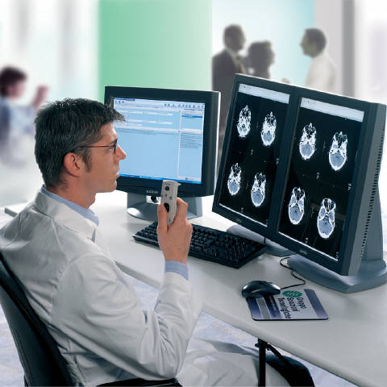
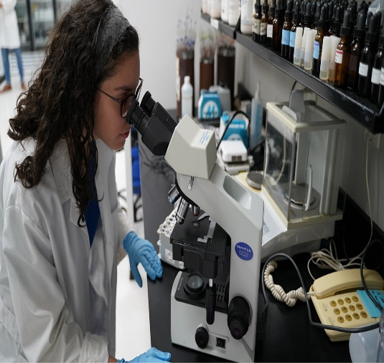
Stakeholders: Medical Professionals
Oncologists
Radiologists
Pathologists
15

Slide 16
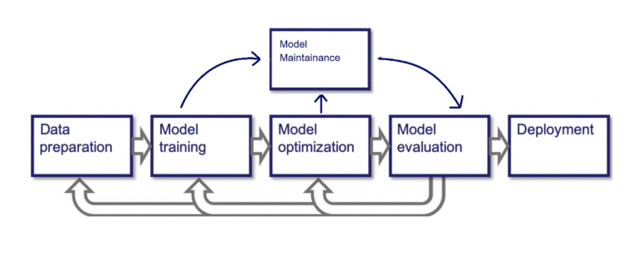
System architecture

Slide 17
Data Collection
We used Kvasir datasets and CVC-612 dataset.
Kvasir
Kvasir-seg
500 normal images
500 polyp images
1000 images with its masks.
Kvasir-sessile
196 images used for prediction only.
Hyper-Kvasir
CVC-612
1000 images with its masks.
612 images from 31 colonoscopy sequences with its masks.
17

Slide 18
Preprocessing and Post processing
01
Resized the images and masks.
02
Applied median bluer with kernel size of 3.
03
04
Converted the masks into grayscale.
Data Augmentation.
05
Normalized masks
06
Applied binary dilation to masks with radius of 5 pixels.
07
Splitting the data into training, validation and testing.
08
Get contours of the predicted mask.
18

Slide 19
Data Augmentation
 | Techniques | Images before augmentation | Images after augmentation
Classification | Rotation range. Width shift range. Height shift range. Horizontal flip. Vertical flip. Brightness range. | 1000 | 3000
Segmentation | Augment Kvasir-seg, Hyper Kvasir and CVC-612. | Each one is 1000 except CVC-612 is 612 | 2612
 | Random rotate. Horizontal flip. Vertical flip. | 2612 | 10448
19

Slide 20
Data splitting
1680 training
Classification
900 validation
420 testing
5850 training
Segmentation
2508 validation
2090 testing
20

Slide 21
Contour of mask
Binary dilation of mask
21

Slide 22

Modeling, training and evaluation
1. Classification models
VGG16
Resnet50
50 epochs
120 Batch size
Binary-cross entropy
Adam
50 epochs
120 Batch size
Binary-cross entropy
Adam & SGD
22

Slide 23
Evaluation of the classification models
Accuracy = (TP + TN) / (TP+ FP + TN+ FN)
Precision = TP / (TP + FP)
Recall = TP / (TP + FN)
MCC = (TP × TN - FP × FN) / sqrt((TP + FP) × (TP +FN)× (TN + FP) × (TN + FN))
23

Slide 24
Results of the classification models
Classification steps | Accuracy | Precision | Recall | MCC
VGG16 + pure dataset | 73% | 74% | 74% | 73.5%
VGG16 after preprocessing + grayscale + SoftMax | 87% | 88% | 89% | 87%
VGG16 + grayscale + sigmoid | 92% | 93% | 93% | 90%
VGG16 + RGB + SoftMax | 97% | 97% | 98% | 98%
VGG16 + RGB + sigmoid | 98.5% | 98.5% | 99% | 99%
resnet50 + RGB + SoftMax + SGD | 97.5% | 96.5% | 98.5% | 96%
resnet50 + RGB + sigmoid + Adam | 99.5% | 99% | 99.5% | 98.7%
24

Slide 25
Comparison between our work and others
Paper | Model | Accuracy
Konstantin Pogorelov & Kristin Ranheim Randel & Carsten Griwodz & Thomas de Lange | 3-layers CNN | 95%
John Mitchell | VGG16 | 96.33%
Our work | Resnet50 | 99.5%
25

Slide 26
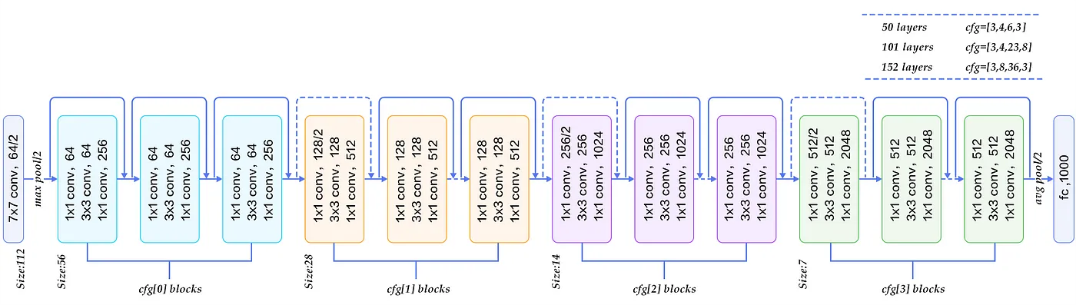
Architecture of Resnet50
26

Slide 27
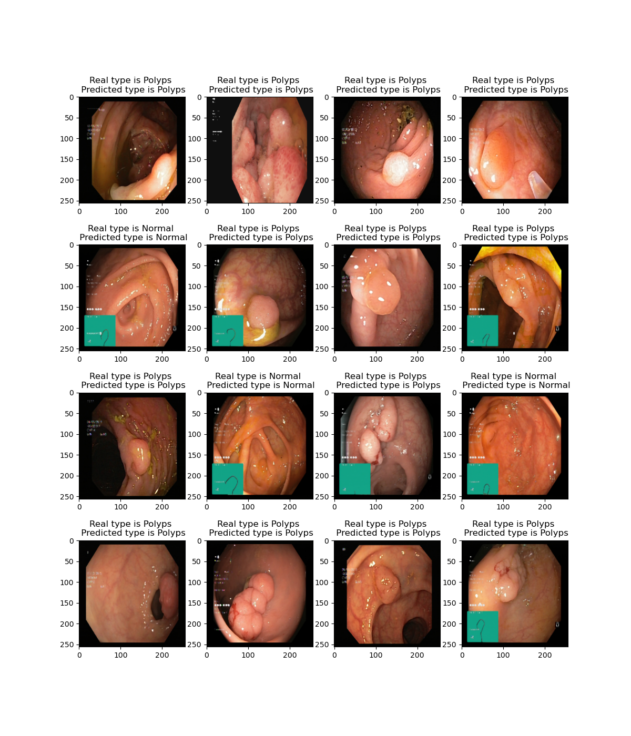
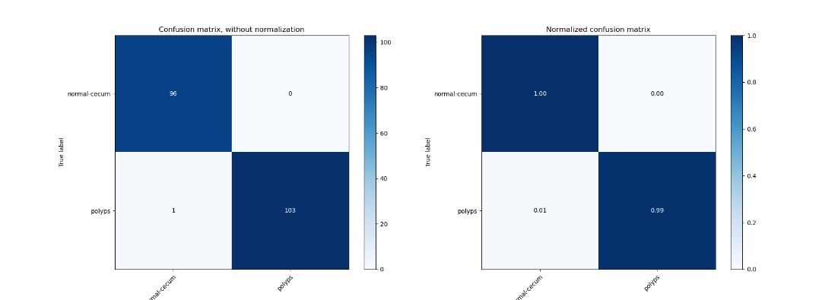
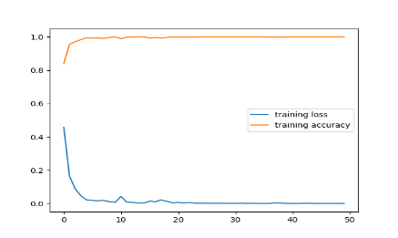
27

Slide 28
Modeling, training and evaluation
2. Segmentation models
U-net
Res Unet
Res Unet++
100 epochs
32 Batch size
Binary-cross entropy & dice loss
Adam
100 epochs
8 Batch size
Binary-cross entropy & dice loss
Adam
100 epochs
16 Batch size
Binary-cross entropy & dice loss
Adam & Nadam.
28

Slide 29
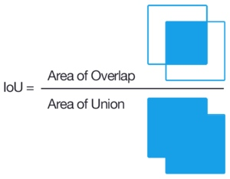
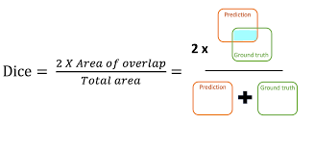
Evaluation of the segmentation models
29

Slide 30
Results of the segmentation models
Segmentation steps | Accuracy | Mean IOU | Mean Dice | Binary cross-entropy loss | Dice loss
U-net with pure data | 95% | 65% | 68% | 35% | 32%
U-net without augmentation | 97.6% | 86% | 88% | 13% | 12%
Unet with augmentation | 97.2% | 83% | 91% | 14.47% | 9%
Res-Unet with augmentation | 97% | 82% | 90% | 17.23% | 10%
Res-Unet++ with augmentation and Nadam optimizer | 99% | 91% | 95% | 5% | 5%
30

Slide 31
Comparison between our work and others
Paper | Model | Mean IOU | Mean Dice
Ange Lou & Shuyue Guan & Murray Loew | CaraNet | 88% | 93%
Ibtesam M. Dheir & Samy S. Abu Naser | Res-Unet++ + CRF + TTA | 83.29% | 85.08%
Nikhil Kumar Tomar | RUPNet | 76.58% | 65.53%
Our work | Res-Unet++ | 91% | 95%
31

Slide 32
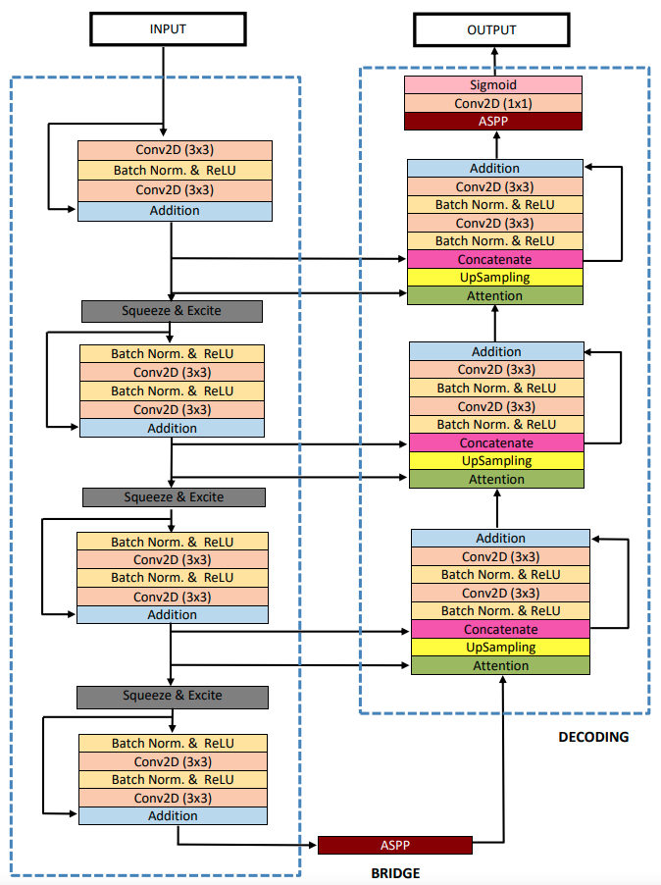
Architecture of Res-Unet++
32

Slide 33
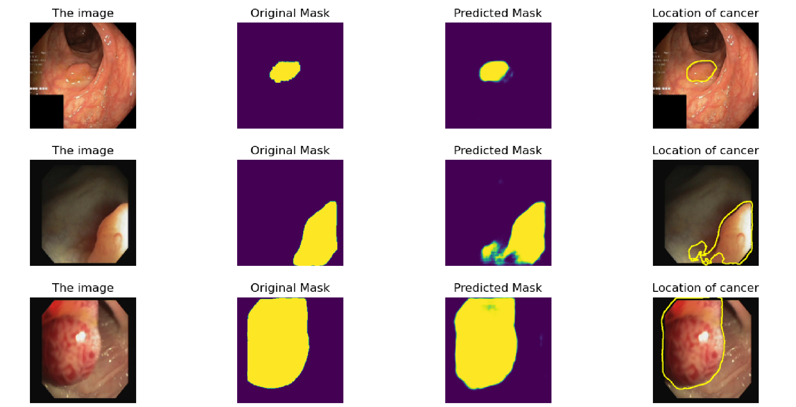
33

Slide 34


Deployment
Technologies used in deployment:
Flask
HTML
CSS
Javascript
Ajax Call
Jquery
MySQL database
34

Slide 35
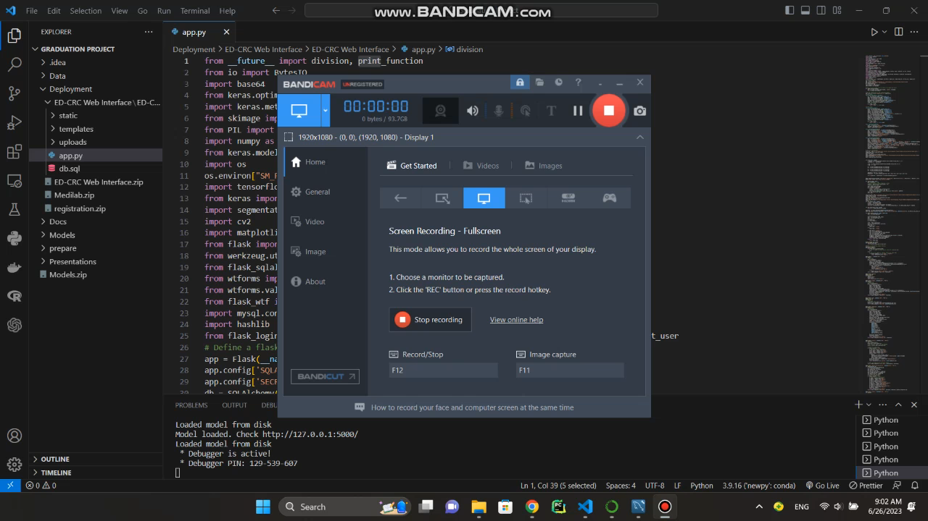
Demo of our website
35

Slide 36
Our database
36

Slide 37
Time plan
37

Slide 38
Conclusion
Early detection of colon cancer using advanced classification and segmentation techniques.
Our results surpassed those reported in previous research papers.
We were able to accurately identify tumors and the location of them in the colon.
This early detection has the potential to improve patient outcomes, by allowing for prompt treatment and potentially preventing the cancer from spreading.
38

Slide 39
References
Boesch, G. (2023, January 1). A complete guide to Image Classification in 2023. viso.ai. Retrieved February 12, 2023,Jha, D. et al. (2020). Kvasir-SEG: A Segmented Polyp Dataset. In: , et al. MultiMedia Modeling. MMM 2020. Lecture Notes in Computer Science(), vol 11962. Springer, Cham.
Common cancer sites - cancer stat facts. SEER. (n.d.). Retrieved February 17, 2023.
Dheir.M.S&Abu naser.S.S(2022)International Journal of Academic Engineering Research,"Classification of Anomalies in Gastrointestinal Tract Using Deep Learning”(6)3,:15-28.
Jha, D., Smedsrud, P. H., Johansen, D., de Lange, T., Johansen, H. D., Halvorsen, P., & Riegler, M. A. (2021). A Comprehensive Study on Colorectal Polyp Segmentation With ResUNet++, Conditional Random Field and Test-Time Augmentation. IEEE journal of biomedical and health informatics, 25(6), 2029–2040.
Jha, D., Smedsrud, P. H., Riegler, M. A., Johansen, D., De Lange, T., Halvorsen, P., & Johansen, H. D. (2019, December). Resunet++: An advanced architecture for medical image segmentation. In 2019 IEEE International Symposium on Multimedia (ISM) (pp. 225-2255). IEEE.
Konstantin Pogorelov, Kristin Ranheim Randel, Carsten Griwodz, Sigrun Losada Eskeland, Thomas de Lange, Dag Johansen, Concetto Spampinato, Duc-Tien Dang-Nguyen, Mathias Lux, Peter Thelin Schmidt, Michael Riegler, and Pal Halvorsen. 2017. KVASIR: A Multi-Class Image Dataset for Computer Aided Gastrointestinal Disease.
Pogorelov, Konstantin & Randel, Kristin & Griwodz, Carsten & de Lange, Thomas & Eskeland, Sigrun & Johansen, Dag & Spampinato, Concetto & Dang Nguyen, Duc Tien & Lux, Mathias & Schmidt, Peter & Riegler, Michael & Halvorsen, Pål. (2017). KVASIR: A Multi-Class Image Dataset for Computer Aided Gastrointestinal Disease Detection. 10.1145/3083187.3083212
ZhiFei Lai, HuiFang Deng, "Medical Image Classification Based on Deep Features Extracted by Deep Model and Statistic Feature Fusion with Multilayer Perceptron‬", Computational Intelligence and Neuroscience, vol. 2018, Article ID 2061516, 13 pages, 2018.
Zhou, Z., Rahman Siddiquee, M.M., Tajbakhsh, N., Liang, J. (2018). UNet++: A Nested U-Net Architecture for Medical Image Segmentation. In: , et al. Deep Learning in Medical Image Analysis and Multimodal Learning for Clinical Decision Support. DLMIA ML-CDS 2018 2018. Lecture Notes in Computer Science(), vol 11045. Springer, Cham.
39

Slide 40
THANK YOU
^_^
Implemented by
IDs | Students’ names
20198062 | Amr Yehia Zakaria
20198021 | Gamal Hanafi Khalil
20198071 | Mohamed Ramadan Mohamed
20188045 | Mahmoud Khaled Helmy
20198102 | Yomna Farid Mohamed
Supervised by
Prof. Abeer El-Korany
Dr. Ibrahim Zaghloul
TA. Eng. Menna Youssef

